Slide 1
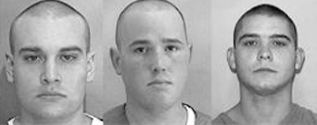
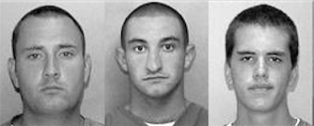

SDT in justice system
Line-ups and eyewitness identification
Mikołaj Wieczór, M.A.
Faculty of Psychology and Cognitive Science, AMU Poznan

Slide 2

Ronald Cotton: Wrongful Conviction by Misidentification
In 1984, 23‑year‑old Ronald Cotton was arrested and charged with rape in Burlington, North Carolina. Jennifer Thompson–Cannino, the victim, provided a detailed description of her assailant and later identified Cotton in a photo lineup. Confident in her memory, she testified that he was the man who attacked her. Based largely on her testimony and identification, the jury convicted Cotton, and he was sentenced to life plus 54 years in prison.
Despite his persistent claims of innocence, Cotton spent over 10 years behind bars. It wasn’t until 1994, when the Innocence Project took up his case and arranged DNA testing of evidence from the crime scene, that the truth emerged: the DNA excluded Cotton and instead matched another man, Bobby Poole, who confessed to the crime. In 1995, Cotton’s conviction was vacated, and he was finally released.

Slide 3

Stakes of eyewitness identification
Consequences of a False Alarm: A “false positive” in legal contexts can devastate innocent lives. Cotton’s case shows how a single mistaken identification (a false alarm) can override other evidence, leading to a grave miscarriage of justice.
Of course, miss is also to be avoided (guilty person walking free)
Innocence Project: almost 60% of wrongful convictions were based on eyewitness misidentification
From the perspective of justice system, it is important to maximise hits (correct identifications) while keeping false alarms low.

Slide 4

Perspective of justice system
Good eyewitness identification procedure should:
maximise the number of
correct line-up rejections
correct identifications
minimise the number of
incorrect line-up rejections
incorrect identifications of innocent suspects
In SDT terms: we want to create conditions that increase d’ instead of only affecting criterion placement (which is quite easy to do)

Slide 5
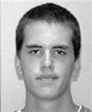
Lineups
Identifying the suspect from among foils (people known to be innocent) – the suspect can be guilty (a target-present lineup) or innocent (a target-absent lineup);
Guilty suspect identified is a hit, but an innocent suspect identified is a false alarm;
Line-ups vs. show-ups (which should be avoided)
Show-up
Line-up

Slide 6
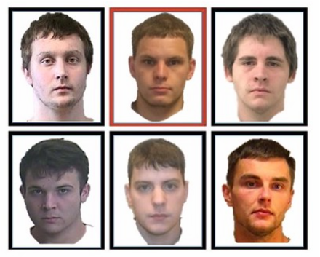
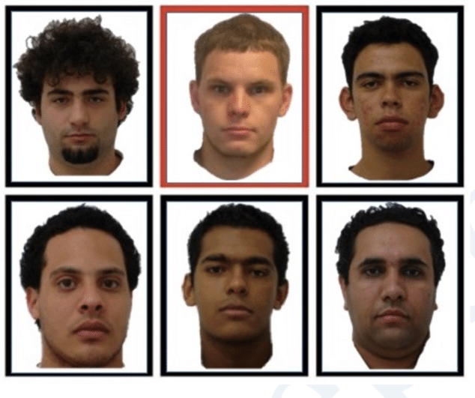
Fair vs. unfair lineups
A fair line-up protects suspect from drawing too much attention.
In unfair line-up suspect stands out, thus increasing risk of faulty identification.
Fair line-up
Unfair (biased) line-up

Slide 7
Eyewitness ID & STD
In show-up all incorrect ID fall on innocent suspect.
In line-ups known-to-be innocent fillers protect suspect from erroneous ID (filler siphoning).
In real-life scenario police doesn’t know whether suspect is guilty or not – an eyewitness is needed to confirm this (or not).
In a lab setting proportion of guilty and innocent suspects in line-ups is set – this way we can compare different conditions that may influence accuracy and bias.
Show-up | Guilty suspect | Innocent suspect
That’s the guy! | Hit | False alarm
That’s not him! | Miss | Correct rejection

Slide 8
Eyewitness ID & Base Rates
In real-life base rates of guilty to innocent suspects are unknown – so we don’t know how prevalent are perpetrators in line-ups (or in any other eyewitness ID)
But it could be estimated - Wixted, Mickes, Dunn, Clark, & Wells (2016) – fitting SDT to real-life data (from Houston) gave an estimate of 35% target-present lineups
Evidence-based suspicion: there should be evidence-based grounds to suspect that an individual is guilty of the specific crime being investigated before including that individual in an identification procedure and that evidence should be documented in writing prior to the lineup.
Lineups as a diagnosis – you don’t test anyone, anytime, unless you suspect something is wrong.

Slide 9
Distributions in eyewitness ID
NEW OLD
On average guilty suspects are more familiar than innocent ones (those who wasn’t present on the crime scene or foils)
Greater d’ represents better memory for the perpetrator
Innocent suspect distribution
Guilty suspect distribution
Memory strength
(familiarity)
(Decision) Criterion

Slide 10
What affects eyewitness memory?
System variables:
Variables under control of the criminal justice system;
Typically related to retrieval conditions – there is not much one can do about encoding of a crime;
They remain the main subject of experimental work aimed at designing good investigative techniques:
Wells, G. L., Kovera, M. B., Douglass, A. B., Brewer, N., Meissner, C. A., & Wixted, J. T. (2020). Policy and procedure recommendations for the collection and preservation of eyewitness identification evidence. Law and Human Behavior, 44, 3-36.
Estimator variables:
They affect the reliability of identifications, but we cannot control for them;
Encoding conditions:
Distance, light, weather, etc. – viewing conditions; the weapon focus effect;
Stress, intoxication – witness conditions;
Passage of time – more time passed = worse memory
Own-race bias – better hit rate when witness and suspect are of the same race/ethnicity.
We need to account for them in judging whether a given identification is likely to be correct.

Slide 11
Quantifying eyewitness accuracy
Older studies (e.g. Wells & Lindsey, 1980) used diagnosticity ratio (D), a simple proportion of HR to FAR. This led them to conclude that sequential line-ups (six photos presented one-by-one) are better than simultaneous line-ups (all six photos showed at once): D = 7,2 vs. 5,8.
But this metric is not independent of bias (criterion placement) and might be different if criterion is switched → so we need a measure that encompass accuracy at different levels of bias.
SDT assumes that different levels of bias can be expressed by different levels of confidence in each decision. So, if someone is very confident it usually means that his/her identification decision is correct.
So, a good practice is to collect confidence statement after ID decision.
ROC (Receiver Operating Characteristic) curves can show the proportions of hits to false alarms at different levels of bias.

Slide 12
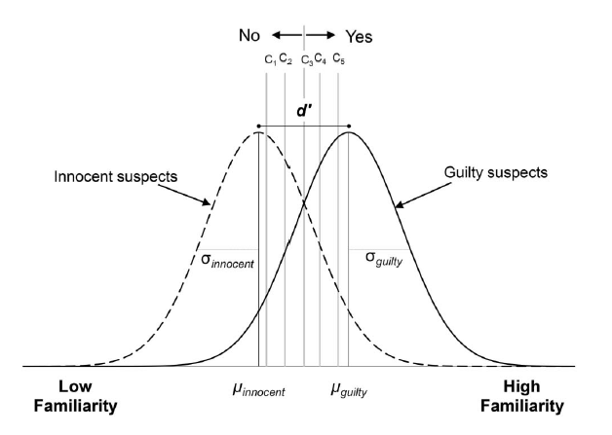
Confidence in eyewitness ID
• The more conservative someone is – the more to the right the criterion is placed – the fewer correct and fewer erroneous identifications occur.
• The relative drop in erroneous identifications is faster than the relative drop in correct identifications, because the distribution of the guilty suspects is shifted to the right.
• At the highest levels of confidence almost all identifications are correct – identifying someone with high confidence means that witness has a very high familiarity signal when seeing a suspect.

Slide 13
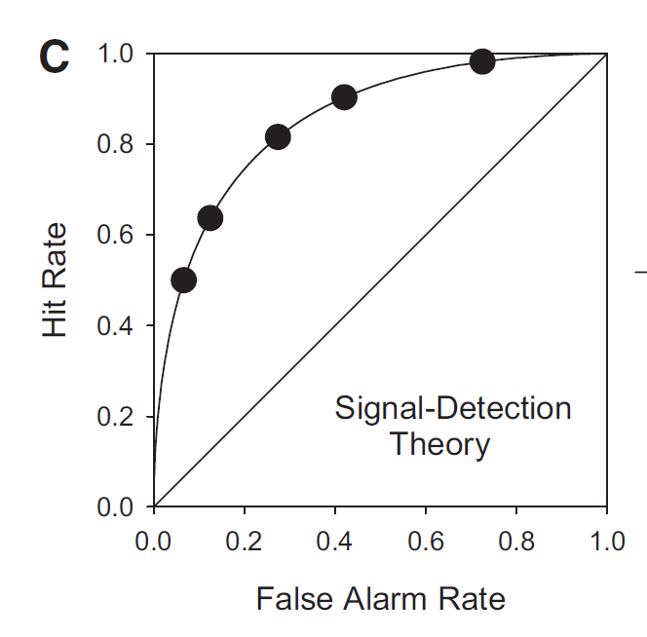
ROCs and confidence
C1
C2
C3
C4
C5

Slide 14
ROCs
Each point corresponds to a different level of bias;
Bias becomes more liberal as we move along the line to the right;
ROCs are curvilinear according to the SDT – e.g., when you go from extremely confident to highly confident responses (5 to 4), you gain a lot of hits but an increase in false alarms is negligible; by contrast, when you move from low confidence to very low confidence (2 to 1), you increase false alarms substantially, but you do not get many additional hits.
Overall memory (d’) is equal in each level of bias.
We can compare different curves for different conditions, procedures, etc.

Slide 15
How to compare ROCs?
The more area under the curve the better! In other words, if ROC is bending more toward the upper-left corner the better.
We can inspect it visually or look at Area Under the Curve (AUC) value for each ROC.
The solid line in the middle symbolizes chance performance – as if decision was made by guessing – if ROC is flat, it means that someone can’t really tell signal from noise.
Performance is better in ROC 1 compared to ROC 2
ROC 1
ROC 2

Slide 16
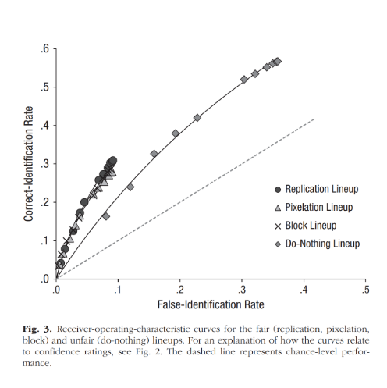
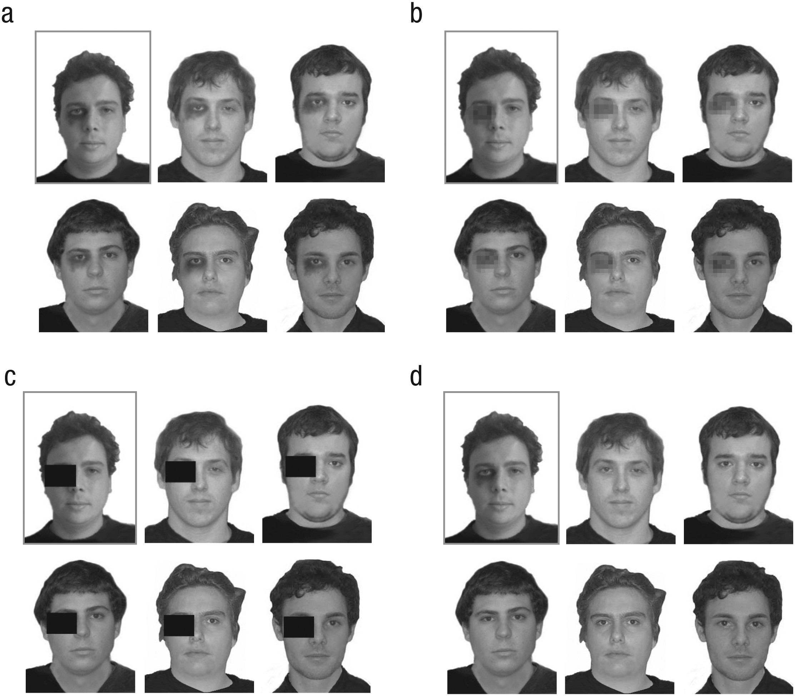
“Real” ROCs – feature addition and removal

Slide 17
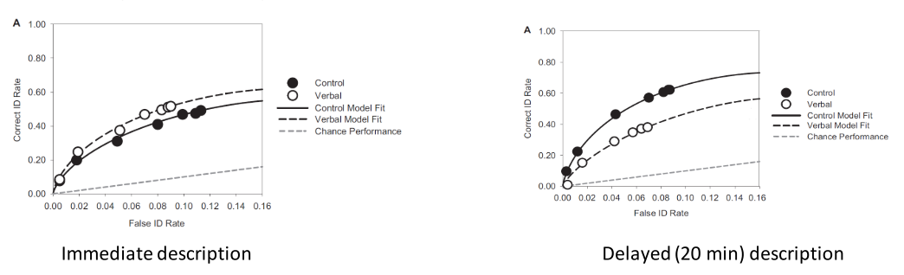
“Real” ROCs – verbal overshadowing
An effect where describing a face distorts memory for that face
But this effect is known to be rather small
Wilson, Seale-Carlisle, & Mickes (2018) study – results below

Slide 18
Let’s create our own ROC!
Online ROC Curve Calculator (Johns Hopkins University)
It is important to get the data formatting right
This calculator provides 5 types of data formats to choose from (we’ll use data type 2)
Each participant was presented with 1 target-present and 1 target-absent show-up, gave response and indicated confidence (1-3)
Target present/absent (1/0) | (left blank) | Response of participant (target present/absent; 1/0) | (left blank) | Confidence rating
1 | - | 1 | - | 3
0 | - | 0 | - | 2

Slide 19
How about real experimental data analysis?
Experiment checking how similarity of foils to suspect affects discrimination performance
People were shown pictures of “guilty suspect”, after a few minutes were presented with show-up, 2-preson line-up and 6-person line-up (half target present, half target absent)
There were two groups:
Foils in their ID tasks were very similar to the suspect (higher similarity than usual)
Foils were about as similar as in standard, fair line-up
For sake of simplicity, we’ll focus on the show-up data
We’ll calculate SDT measures for both groups and then draw ROCs for those

